Slide 1

GitHub Enterprise Solutions
Digital Transformation & Security Best Practices
Ravi Kumar
Solutions Architect/ Project Delivery/Eng. Mgmt.

Slide 2

MyCart Inc – Goals, Objectives & Challenges
Business Goals
MyCart Inc is growing at a rapid phase, patient sign up has gone up, and the goal is to achieve 40 million users by 2025
The goal is to meet the growing user demand, build and support the online portal by hiring the required resources, onboarding and off-boarding employees
Implement a seamless experience for Internal teams, ensure security and development best practices
Business Challenges
MyCart Inc choose GitHub, Introducing a new tool, or a solution means new security challenges
Managing users in GitHub, security at the organizational level and unit level is a challenge
Seamless adoption of GHE as part of the Digital Transformation Journey
Business Objectives
GitHub solutions should fall in line with MyCart Inc IT security policies
Enforce best security practices for GitHub solutions, and create secure environments
MyCart has hundreds of repositories, so ensure proper code reviews to code being added into GitHub repositories

Slide 3

Digital Transformation
Transform your software engineering practices with GitHub Enterprise
GitHub - a comprehensive solution that allows teams to adopt and apply modern application lifecycle management practices at their own pace to eliminate delivery impediments and transition to a continuous delivery cadence.
1. Remote work has accelerated digital transformation and changed how we collaborate
2. The technology landscape continues to evolve. In some cases, we have to continue maintaining complex technology stacks
3. Security is more important than ever; from the code, we write to the dependencies that we rely upon
4. Recruiting, retaining talent, and the developer experience is crucial

Slide 4
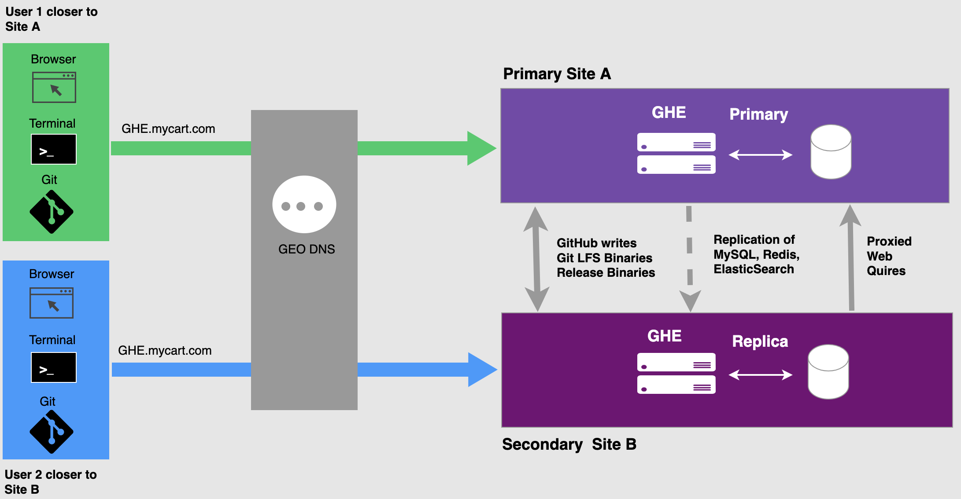
GitHub Enterprise Hosting & Solutions
GitHub Enterprise includes two deployment options: choose based on business, security and compliance requirements
Self Hosted
Cloud Hosting
GitHub is responsible for the High Availability and SLAs
GitHub self hosted MyCart Inc is responsible for High Availability
Advanced security features:
Code scanning
Secret scanning
Dependency review

Slide 5



GHE Security and Administration
Three Pillars
Access Control
Observability
Governance
Private means private
Role base access control
Centralized account management and SSO
Network access control
Comprehensive logs
Every project and member
Available in security tools you already use
Centralized policies
Coverage across the development lifecycle
Flexible hierarchies

Slide 6
Ensuring proper onboarding and off-boarding of employees:
How to ensure a “Bad Leaver” does not become a threat to our business?
How to ensure new employees have access to the tools they need to start working as soon as they join?
User & group lifecycle management from a single environment:
How to ensure I don’t have to re-work established groups for each application my employees should have access to
User Provisioning
User Security
Automation

Slide 7
SCIM
SCIM (System Cross-Domain Identity Management
SCIM focus is on User Management which translates to provisioning and automation
SCIM automates User Lifecycle management in your organization
SCIM
Feature Overview
Impact
Features
Enables centralized user management
Allows to synchronize groups from your Identity Provider to teams in your organization
Automate onboarding and offboarding process within GitHub

Slide 8


Implementation steps
Organization at GitHub
Identity Provider: Azure AD
SAML Established trusted relationship between Azure AD and MyCartInc-Search
SCIM Provisioning enabled on top SAML
What will be presented:
Onboarding a new user manually into Identity Provider
Watching this new user being provisioned and being invited to join this organization

Slide 9
Code Reviews & Scans
Reviews & Security at Scale
Automation
GHE

Slide 10
Code Reviews & Vulnerability Scans
Benefits of code reviews & Vulnerability Scans
Catch Bugs
Catch code quality issues
Learning opportunities for the
Pull request creator
Reviewer
An exchange of best practices and experiences
Keeping developers in Sync
Meant to write better software and reduce the introduction of software vulnerabilities
Code Reviews
Code Scans
Reasons
Quality decreases as the software grows
The later you catch a bug, the more expensive it is to fix
Software bugs and vulnerabilities can lead to security breaches

Slide 11

Down Sides of Code Reviews & Scans
Organizations Culture & DevOps Culture
Manual code review is a process of reading source code line-by-line to identify potential vulnerabilities
Often done by a peer or a QA team
Generally, run through a checklist to identify issues
Manual code reviews amplify both good and bad:
Poor company culture
Difficult personalities
Unprofessional behavior
Leads to:
Unnecessary arguments
Slow down development
Decreased morale

Slide 12
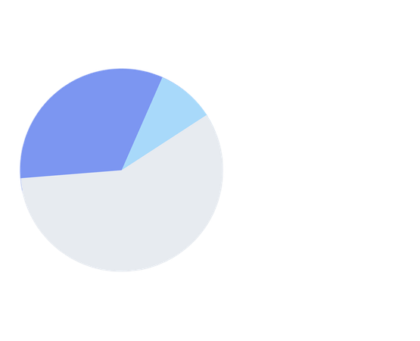
Code Reviews & Scans at Scale
Need for Automated code reviews and scans
THE DEVELOPER WORK WEEK
Greater need for Automation to drive Standards, Rules, and Culture
The process that reviews code without manual intervention using a predefined set of rules
Enriching developer experience
Automated vs Manual code review
Limited human capacity vs code volume through automation
Time spent waiting and time zones
Human error, personal biases, and interpersonal communications
Quality assurance: Human vs machine capacity
13.5 hours
Technical debt
3.8 hours
Bad code
41.1 total hours
Average developer work week
Loss of productive hours means loss of revenue
Sources: Evans Data Corp., CIA Factbook, Stripe research

Slide 13

Automated Code Review & Scan
Interpreter & Complier Code Scans
Static code analysis is performed during the “Code Development” phase and before the “Unit/Component/Integration” testing phases
Review your code with or without executing any code (Compilation or no compilation)
Technical debt avoidance/planning
Security screening
Duplication avoidance
Complexity metrics
Coverage integration
Compliancy
Education on best practices
Automatic maintenance of rules
Recognizes anti-patterns
Source Code Scanning vs Artifact scanning vs container scanning should run as the CI process
Static Code
Analysis & Scans

Slide 14

Development Code Scanning
GitHub Code Scanning
Analyze the code in a GitHub repository to find security vulnerabilities and coding issues
Based on CodeQL, inherited from Semmle and GLTM
Integrated into GitHub, interoperable with third-party code scanning tools that output Static Analysis Results Interchange Format (SARIF) data
Three flavors of code scanning
GitHub Code Scanning
GitHub Native
CodeQL
3rd Party Tools
Pre-built GitHub Actions and Actions workflows
Up and running in minutes
Works only on GitHub
Run the CodeQL CLI in GitHub Actions or any 3rd party CI systems
Upload Results to GitHub
Works only with GitHub-hosted code
Using GitHub Actions, or
Generated externally and uploaded to GitHub
Works only with GitHub-hosted code

Slide 15
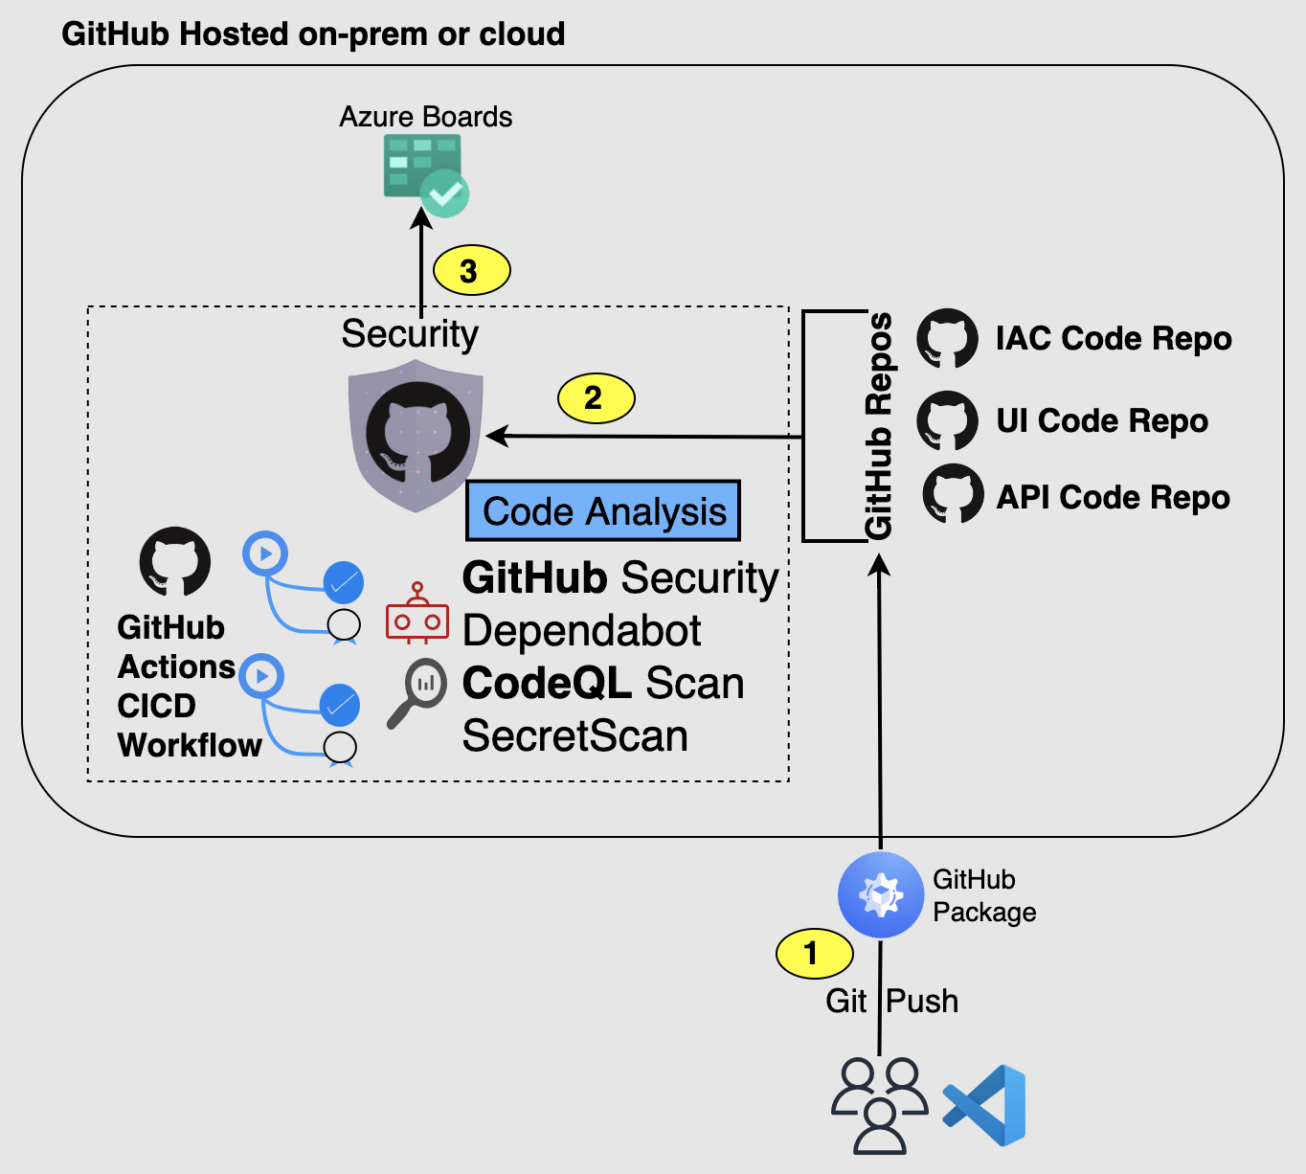
GitHub Code Review and Scanning
Repo Scanning
Supported Languages
Code Scanning/CodeQL supports both complied and interpreted languages
C/C++, C#, GO, Java, JavaScript/TypeScript, Python, Ruby
Quality of Results
Fairly low false positive ration
Can catch issues other tools may not

Slide 16
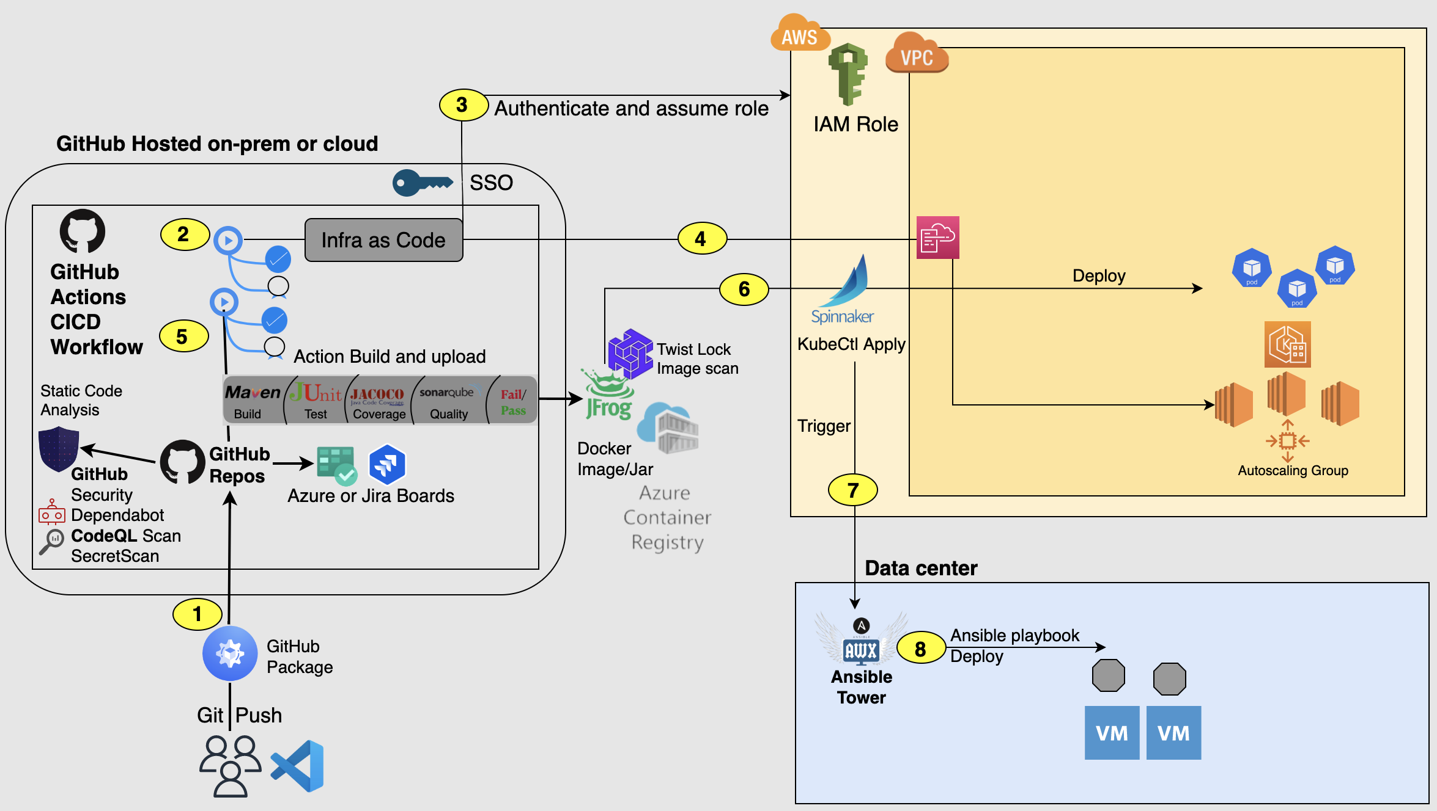
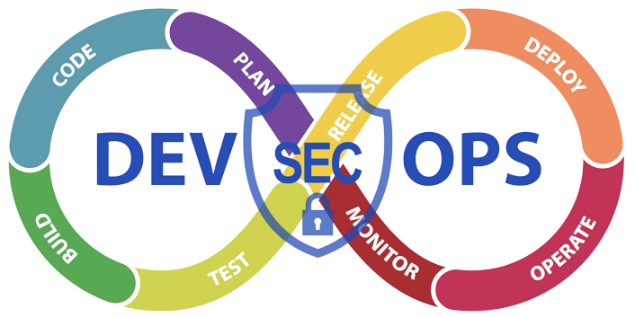
GitHub Enterprise & Deployments
Actions, CI-CD & DevSecOps

